Slide 1
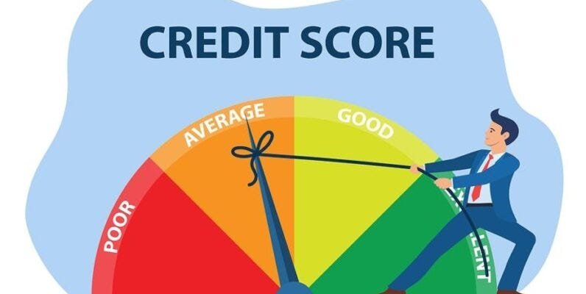
Data Mining Final Project Credit Score Classification

Slide 2
Team
Salman J. Shaikh
Shweta V. Kulkarni
Aakesh K. Murala
Reddy Prasad Rayalam

Slide 3
Business Problem
Build an intelligent system to segregate individuals into credit score brackets, namely poor, standard, and good, in order to reduce manual efforts.

Slide 4
Motivation
The traditional credit score calculation is no longer sufficient for effective loan disbursal or approval as it is solely based on factors related to bank transactions.
Various other factors significantly influence an individual's ability to repay or borrow a loan. Currently, these factors are assessed manually, requiring extensive effort.
Imagine the need to classify individuals' credit scores into three categories. To achieve this, a person with a deep understanding of business is required. This individual must analyze customers based on various factors such as age, job title, and salary to determine their loan repayment capability.
However, this manual approach is both time-consuming and resource-intensive. Evaluating each customer's data individually to categorize them and make loan approval decisions is inefficient and impractical in the long run.

Slide 5
Opportunities available using this analytics
Operations: Utilize analytics to enhance operational efficiency by minimizing manual effort and the need for extensive manpower.
Sales & Marketing: Target customers with good credit scores by tailoring the best possible loan, credit card, or product offers, thus optimizing sales and marketing strategies.
Risk management: Leverage Business analytics to improve risk management. It helps in assisting decisions related to loan approvals and assessing the likelihood of customer loan repayment.
Product development: Utilize analytics to gain insights into customer needs, thereby identifying new product opportunities and enhancing product development strategies.

Slide 6
Problem-Solving Psychology
"Essentially, all models are wrong, but some are useful.“
-- Box, George

Slide 7
Approach
Data Collection
Data Preprocessing
Exploratory data analysis
Feature Engineering
Model Selection
Model Training and Evaluation

Slide 8
Data Collection
We Collected data from Kaggle website.
Link: https://www.kaggle.com/datasets/parisrohan/credit-score-classification/data
Contributor: Rohan Paris Senior Analyst at Citi
https://www.kaggle.com/parisro

Slide 9
Data Overview
Age | Occupation | Annual_Income | Monthly_Inhand_Salary | Num_Bank_Accounts | Num_Credit_Card | Num_of_Loan | Num_of_Delayed_Payment | Changed_Credit_Limit | Num_Credit_Inquiries | Outstanding_Debt | Credit_Utilization_Ratio | Payment_of_Min_Amount | Total_EMI_per_month | Monthly_Balance | Credit_Score
48 | Developer | 105816.45 | 473.9266667 | 4 | 3 | 1 | 12 | 6.37 | 4 | 1342.14 | 38.73342982 | Yes | 79.4959716 | 370.3628329 | Standard
52 | Manager | 109349.31 | 7895.012322 | 2 | 3 | 0 | 1 | 3.93 | 4 | 1292.62 | 31.87395967 | No | 1296.430178 | 852.5190781 | Good
23 | Writer | 8627.12 | 473.9266667 | 10 | 5 | 8 | 17 | 6.98 | 16 | 4578.85 | 30.54426637 | Yes | 57.01333504 | 234.9619964 | Standard
45 | Accountant | 14871.095 | 942.2579167 | 3 | 3 | 2 | 2 | 8.62 | 4 | 725.09 | 28.99988536 | No | 23.61909191 | 265.7832012 | Good
23 | Engineer | 88556.58 | 7464.715 | 6 | 3 | 100 | 19 | 2.16 | 3 | 968.19 | 40.48647074 | No | 61.13806926 | 770.0889389 | Standard
38 | Architect | 24879.05 | 2085.254167 | 3 | 4 | 3 | 20 | 16.73 | 6 | 479.64 | 37.83884748 | Yes | 49.10550756 | 349.6779347 | Standard

Slide 10
Data Preprocessing : Null values handling
Identified null values using appropriate code during the import process.
Applied different strategies for filling null values:
with zero for columns such as Number of Credit Inquiries and Credit History Age.
with the mean for the Salary column.
with the keyword "Unknown" for columns like Credit Mix and Occupation.

Slide 11
Data Preprocessing : Modifying data Types.
Identified numerical columns with object data type due to impure data entries.
Implemented data cleaning steps for columns with mixed data types. For instance, in the "Number of Loan" column, values like ['0_', '3_', '2_', '5_', '8_', '9_', '4_', '7_', '1_', '6_'] were encountered.
Converted these values to strings, applied the strip function to remove extraneous characters (like underscores), and then changed the data type to integer (INT).
Applied similar data cleaning strategies to other columns with impure data entries.

Slide 12
Exploratory Data Analysis (EDA)
Utilized Plotly library for interactive and visually appealing histograms.
Visualized the distributions of various features such as age, annual income, credit history age, etc.
Identified the patterns and trends within the dataset through interactive Plotly plots.
This visualization helped in highlighting the skewness, outliers and central tendencies of key variables.
Investigated correlations between different input columns and the target variable (Credit Score).
Removed irrelevant columns based on correlation analysis to enhance model efficiency.

Slide 13
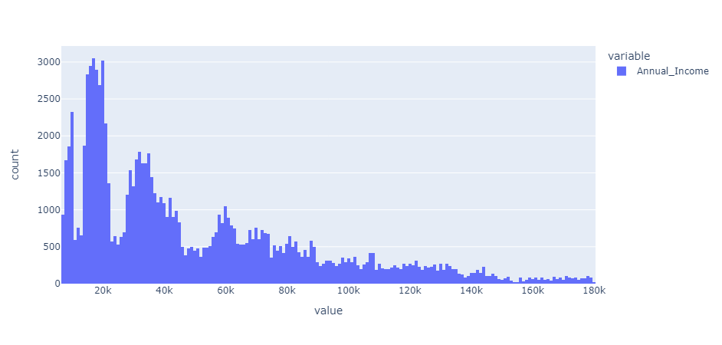
Distribution of Annual Income

Slide 14
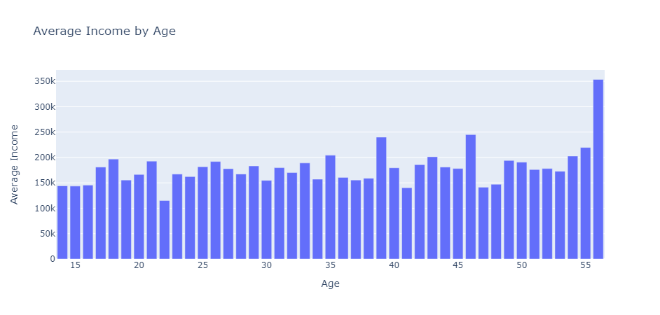
Distribution of Average Income by Age

Slide 15
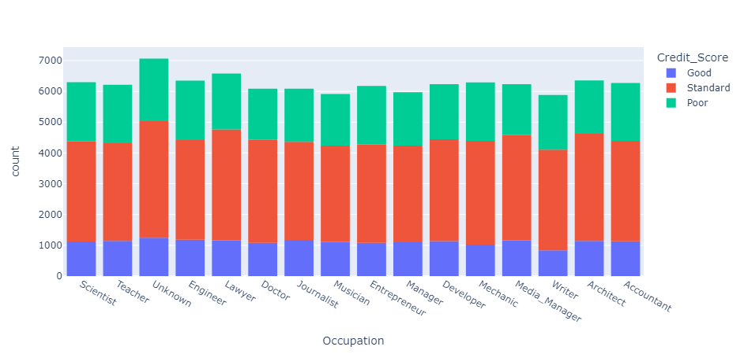
Credit Score vs Occupation

Slide 16
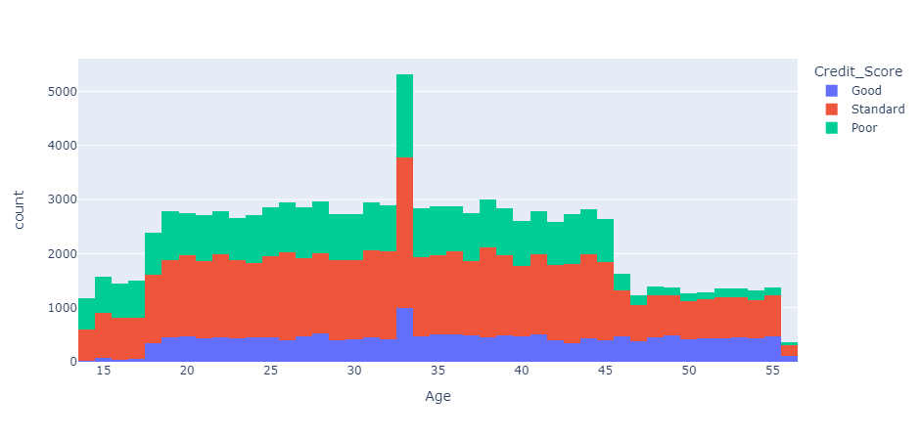
Credit Score vs Age

Slide 17
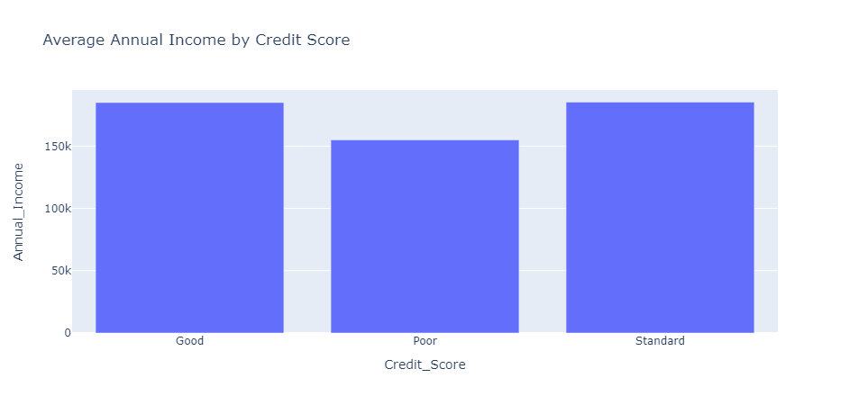
Average Annual Income Vs Credit Score

Slide 18
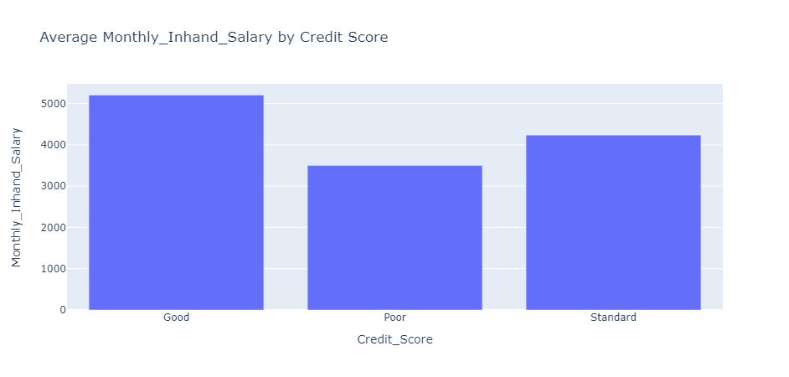
Average monthly salary Vs Credit Score

Slide 19
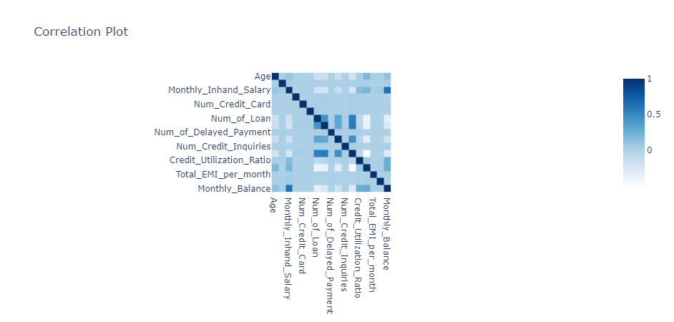
Correlation plot

Slide 20
Feature Engineering
Categorical Variable
Ordinal Encoding
One Hot Encoding
Label Encoding
Numerical Variable
Normalization
Standardization

Slide 21
Model Training
For this classification problem, we selected the following models:
Logistic Regression
Decision Tree
Random Forest Classifier
KNN
XGBoost Classifier

Slide 22
Model Selection
We prioritized models that could accurately predict individuals with credit score categories labeled as 'Good.’
Our primary focus was on the Precision Score.
Through our analysis, we determined that the Random Forest model demonstrated higher precision compared to other models.

Slide 23
Thank You!! Special Thanks to Prof. Abdallah Musmar

